Slide 1
Term break 1

Slide 2
Feedback from last report
Edit TeamGantt into task by task
Example: Task 1
Task 1.1
Task 1.2
Task 2
…..
Edit Diagram (IOT need to change to yellow (Our working))
Literature review: More focusing on how other managing farming system:
Computer system, database structure….
Do a presentation on each meeting

Slide 3
Document Link
Trello : https://trello.com/b/pQTB2a3w/project-61-plant-monitoring-system-to-estimate-harvesting-timing
Gantt Chart : https://app.teamgantt.com/projects/gantt?ids=3873755

Slide 4
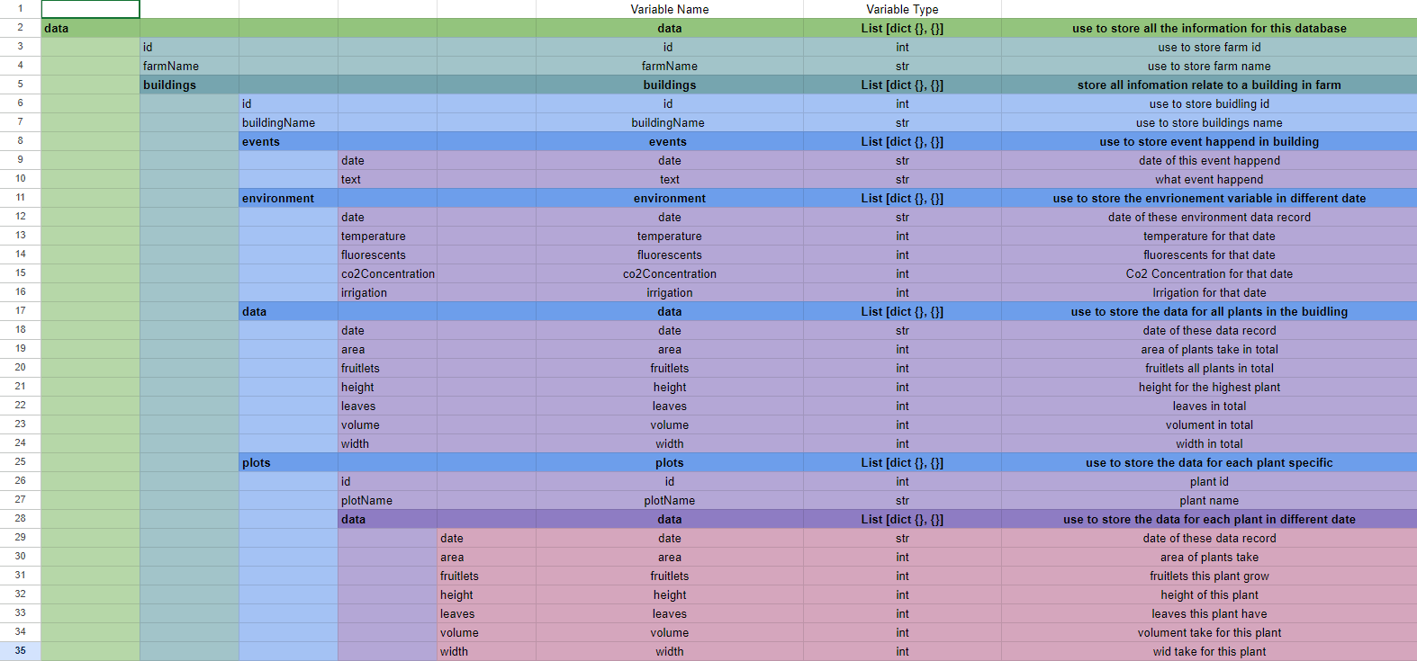
Database Structure

Slide 5
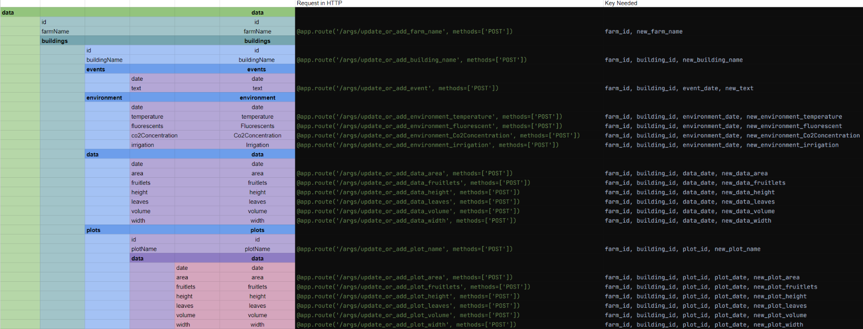
HTTP Request for update data to database base on data structure of frontend

Slide 6
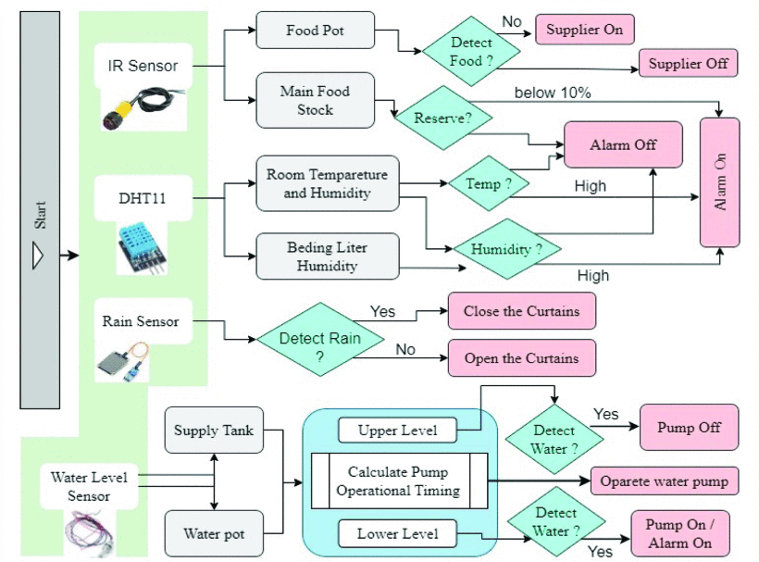
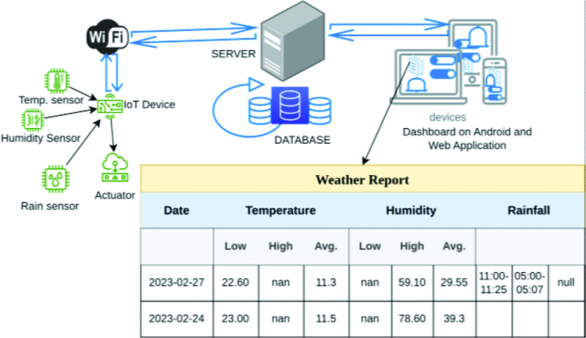
Literature Review
M. Rahman, M. S. R. Kohinoor and A. A. Sami, "Enhancing Poultry Farm Productivity Using IoT-Based Smart Farming Automation System," 2023 26th International Conference on Computer and Information Technology (ICCIT), Cox's Bazar, Bangladesh, 2023, pp. 1-6, doi: 10.1109/ICCIT60459.2023.10441525. keywords: {Smart agriculture;Temperature sensors;Productivity;Automation;Real-time systems;Internet of Things;Farming;smart poultry farming;agricultural automation;sensors;IoT;farm management;Agriculture data analysis},
https://ieeexplore-ieee-org.ezproxy.auckland.ac.nz/document/10441525

Slide 7
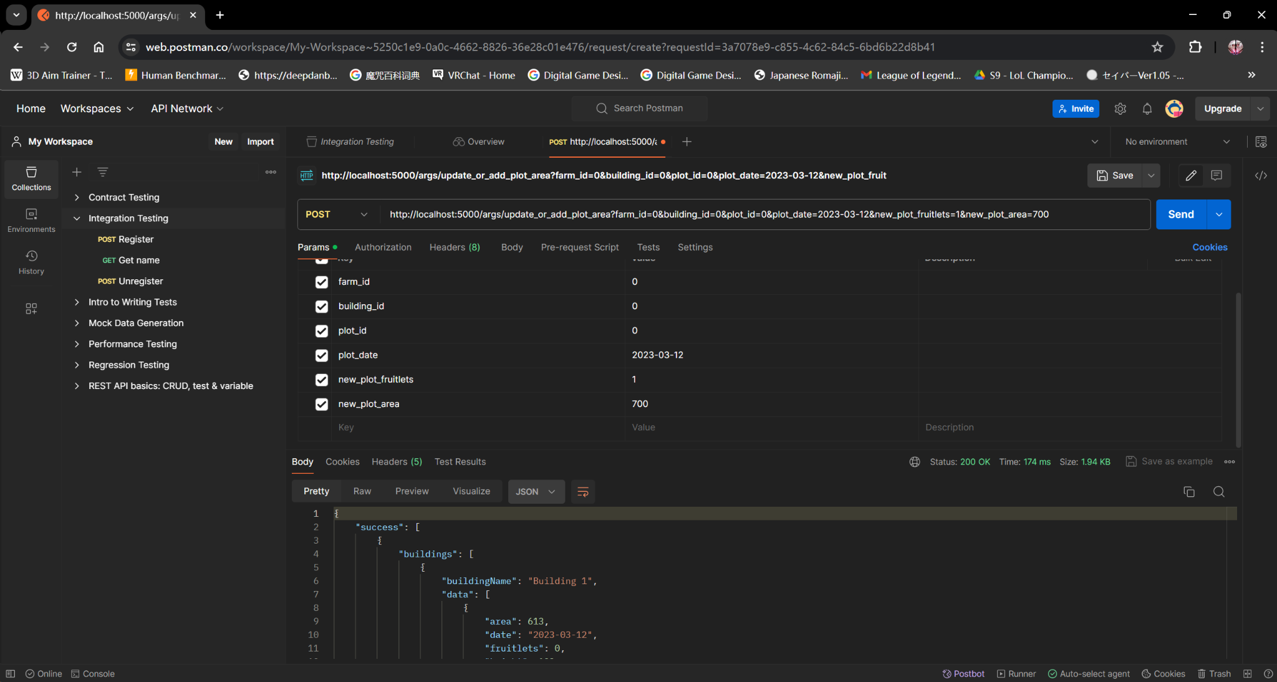
Backend Receive data testing success

Slide 8
Send data from IOT sensor to MySQL.
I kept trying ways to send data directly from IOT sensors to MySQL. However, this method is unstable and has several drawbacks.
Granting remote access to MySQL user account is dangerous in terms of security concerns. Another security concern is that mostly MySQL libraries for ESP32 do not support SSL/TLS.
This method takes a lot of ESP32 memory and CPU storage as the module has to send as well store MySQL queries to the server.
The ESP32 board may run out of memory when processing MySQL response which generally consists of a large amount of data.
Moreover, this method also increases the difficulty of the MySQL script as the server has to process raw data.
The way to send data directly to the server with Mysql_connection.h library. But unfortunately, that way have unknown error and I decide to change the way.
I changed way to send data to MySQL indirectly using HTTP.
There is error when ESP32 board and computer connected with different wifi.
To solve this problem, connect ESP32 board and computer with same wifi.

Slide 9
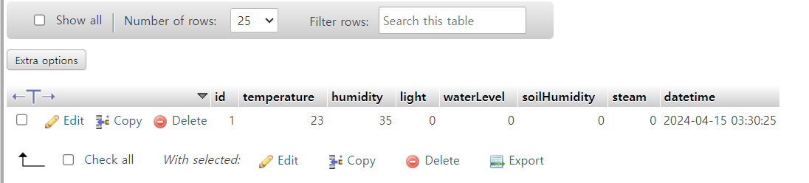
Send data from IOT sensor to MySQL.
ESP32 board and MySQL connected. The test data show on MySQL.
How it works
Step 1: ESP32 includes the data to HTTP/HTTPS request and send the request to the Web server
Step 2: Web server runs a PHP script that handles the request from ESP32
Step 3: PHP Script extracts the data from the HTTP request, processes the data, and then interacts with MySQL database.
Step 4: PHP script processes the result and returns only the necessary result to ESP32 via HTTP response

